Slide 1
19AD784
IMAGE ANALYSIS AND COMPUTER VISION
Dr E Emerson Nithiyaraj
AP/ECE

Slide 2
Elements of Visual Perception
Visual perception refers to the brain's ability to interpret and make sense of visual information received from our eyes.
Developing a basic understanding of human visual perception as a first step.
How images are formed and perceived by humans.

Slide 3
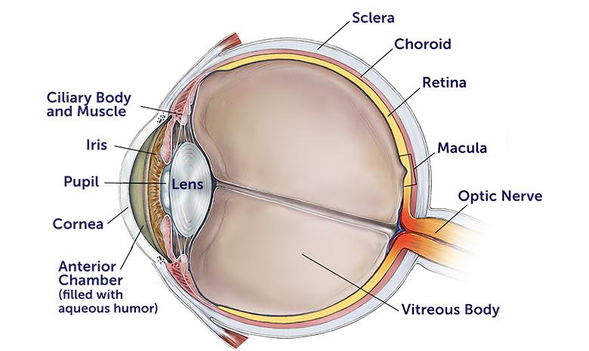
Structure of the Human Eye

Slide 4
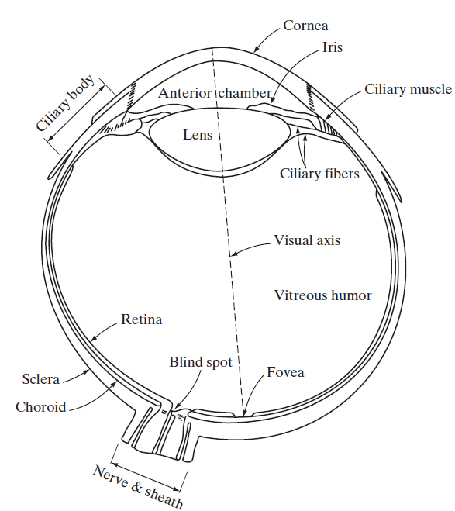
Structure of the Human Eye
A simplified horizontal cross section of the human eye.

Slide 5
The eye is nearly a sphere, with an average diameter of approximately 20 mm.
Three membranes enclose the eye: the cornea and sclera outer cover; the choroid; and the retina.
The cornea is a tough, transparent tissue that covers the anterior surface of the eye.
Continuous with the cornea, the sclera is an opaque membrane (transparent or translucent) that encloses the remainder of the optic globe.

Slide 6
The choroid lies directly below the sclera. This membrane contains a network of blood vessels that serve as the major source of nutrition to the eye.
Even superficial injury to the choroid, often not deemed serious, can lead to severe eye damage as a result of inflammation that restricts blood flow.

Slide 7
The choroid coat is heavily pigmented and hence helps to reduce the amount of extraneous light entering the eye and the backscatter within the optic globe.
At its anterior extreme, the choroid is divided into the ciliary body and the iris.
The iris contracts or expands to control the amount of light that enters the eye.
Pupil: The black circular opening in the iris that allows light to enter the eye.
The central opening of the iris (the pupil) varies in diameter from approximately 2 to 8 mm.

Slide 8
The lens is a transparent structure behind the iris that focuses light onto the retina. It contains 60 to 70% water, about 6% fat, and more protein than any other tissue in the eye.
The lens is colored by a slightly yellow pigmentation that increases with age.
In extreme cases, excessive clouding of the lens, caused by the affliction commonly referred to as cataracts, can lead to poor color discrimination and loss of clear vision.

Slide 9
The innermost membrane of the eye is the retina, which lines the inside of the wall’s entire posterior portion. When the eye is properly focused, light from an object outside the eye is imaged on the retina.
Responsible for converting light into neural signals that can be interpreted by the brain.
Pattern vision is afforded by the distribution of discrete light receptors over the surface of the retina.

Slide 10
There are two classes of receptors: cones and rods.

Slide 11
The cones in each eye number between 6 and 7 million.
They are located primarily in the central portion of the retina, called the fovea, and are highly sensitive to color.
Responsible for color vision and visual acuity in bright light conditions (photopic vision).

Slide 12
The number of rods is much larger: Some 75 to 150 million are distributed over the retinal surface.
Rods serve to give a general, overall picture of the field of view.
Responsible for vision in low light conditions (scotopic vision).
Highly sensitive to light but do not detect color.

Slide 13
For example, objects that appear brightly colored in daylight when seen by moonlight appear as colorless forms because only the rods are stimulated.
This phenomenon is known as scotopic or dim-light vision.

Slide 14
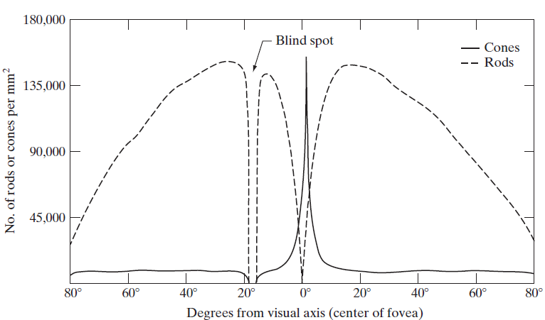
Distribution of rods and cones in the Retina

Slide 15
Image Formation in the eye
In an ordinary photographic camera, the lens has a fixed focal length, and focusing at various distances is achieved by varying the distance between the lens and the imaging plane, where the film (or imaging chip in the case of a digital camera) is located. The image formed by the lens is captured on this plane.
In the human eye, the converse is true; the distance between the lens and the imaging region (the retina) is fixed, and the focal length needed to achieve proper focus is obtained by varying the shape of the lens.

Slide 16
Image Formation in the eye
The fibers in the ciliary body accomplish this, flattening or thickening the lens for distant or near objects, respectively.
The distance between the center of the lens and the retina along the visual axis is approximately 17 mm.

Slide 17
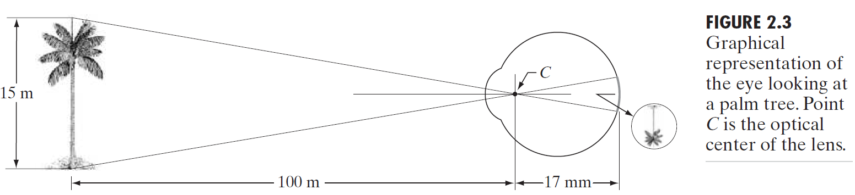
Image Formation in the eye
The geometry in Fig. 2.3 illustrates how to obtain the dimensions of an image formed on the retina.
15/100 = h/17
h = 2.55 mm

Slide 18
Image Formation in the eye
The retinal image is focused primarily on the region of the fovea.
Perception then takes place by the relative excitation of light receptors, which transform radiant energy into electrical impulses that ultimately are decoded by the brain.

Slide 19
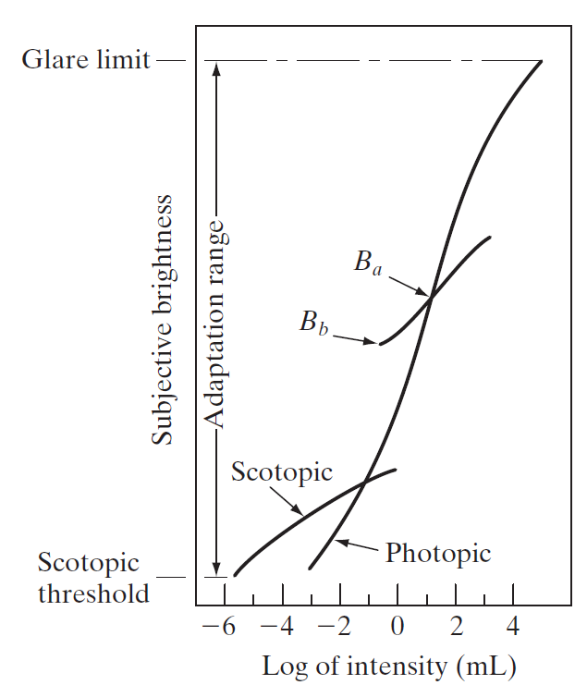
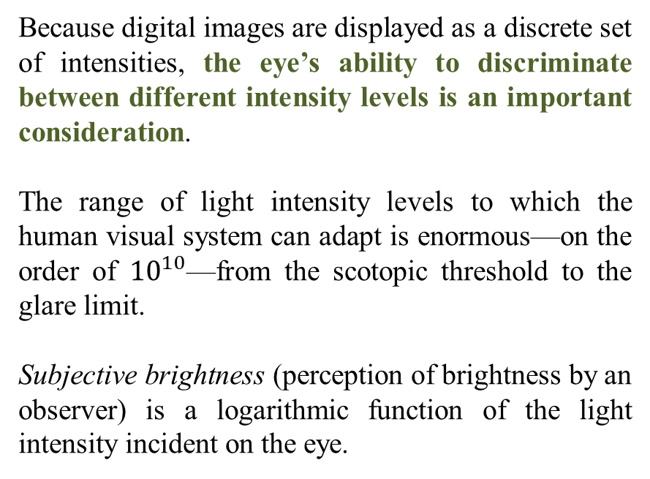
Brightness Adaptation and Discrimination
Because digital images are displayed as a discrete set of intensities, the eye’s ability to discriminate between different intensity levels is an important consideration.
The range of light intensity levels to which the human visual system can adapt is enormous—on the order of ${10}^{10}$—from the scotopic threshold to the glare limit.
Subjective brightness (perception of brightness by an observer) is a logarithmic function of the light intensity incident on the eye.

Slide 20
Brightness Adaptation and Discrimination
The human visual system cannot simultaneously process all levels of brightness (Dynamic Range) equally effectively.
The human visual system employs brightness adaptation. Our eyes adjust their sensitivity. This means they become more or less sensitive to light depending on how bright it is around us.
For any given set of conditions, the current sensitivity level of the visual system is called the brightness adaptation level.

Slide 21
Brightness Adaptation and Discrimination
Brightness discrimination of the eye refers to its ability to distinguish and perceive differences in brightness levels.
The Weber ratio refers to the smallest detectable change in brightness relative to the initial brightness level (I).
If the initial brightness is I and the just noticeable difference (JND) is ΔI, then the Weber ratio ΔI/I​ describes the relative sensitivity of the visual system to changes in brightness.

Slide 22
Brightness Adaptation and Discrimination
A small value means that a small percentage change in intensity is discriminable. This represents “good” brightness discrimination.
Conversely, a large value of means that a large percentage change in intensity is required. This represents “poor” brightness discrimination.

Slide 23
Brightness Adaptation and Discrimination
Two phenomena clearly demonstrate that perceived brightness is not a simple function of intensity.

Slide 24
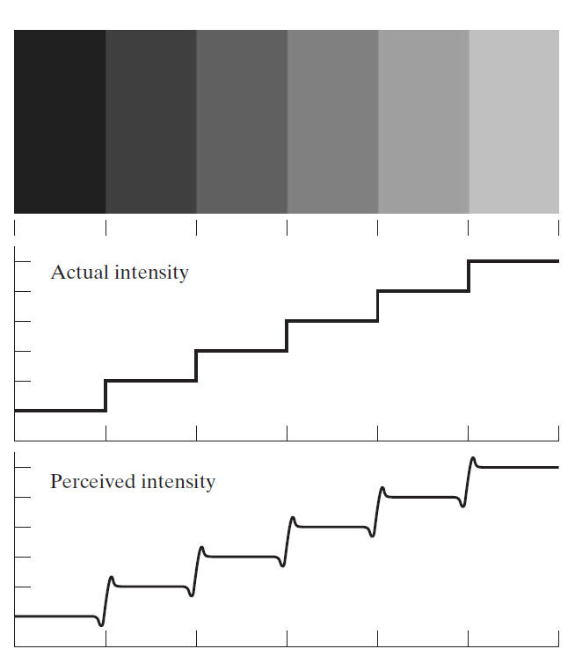
Brightness Adaptation and Discrimination
The first is based on the fact that the visual system tends to undershoot or overshoot around the boundary of regions of different intensities.
Although the intensity of the stripes is constant, we actually perceive a brightness pattern that is strongly scalloped near the boundaries.
These seemingly scalloped bands are called Mach bands after Ernst Mach

Slide 25
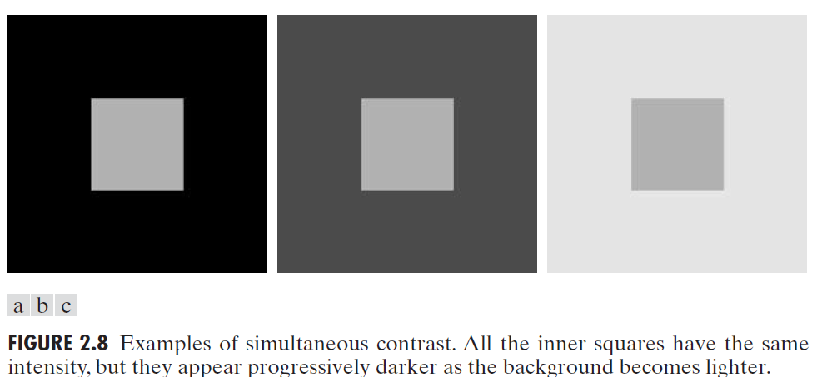
Brightness Adaptation and Discrimination

